Slide 1
Honeywell STEM Challenge

Slide 2
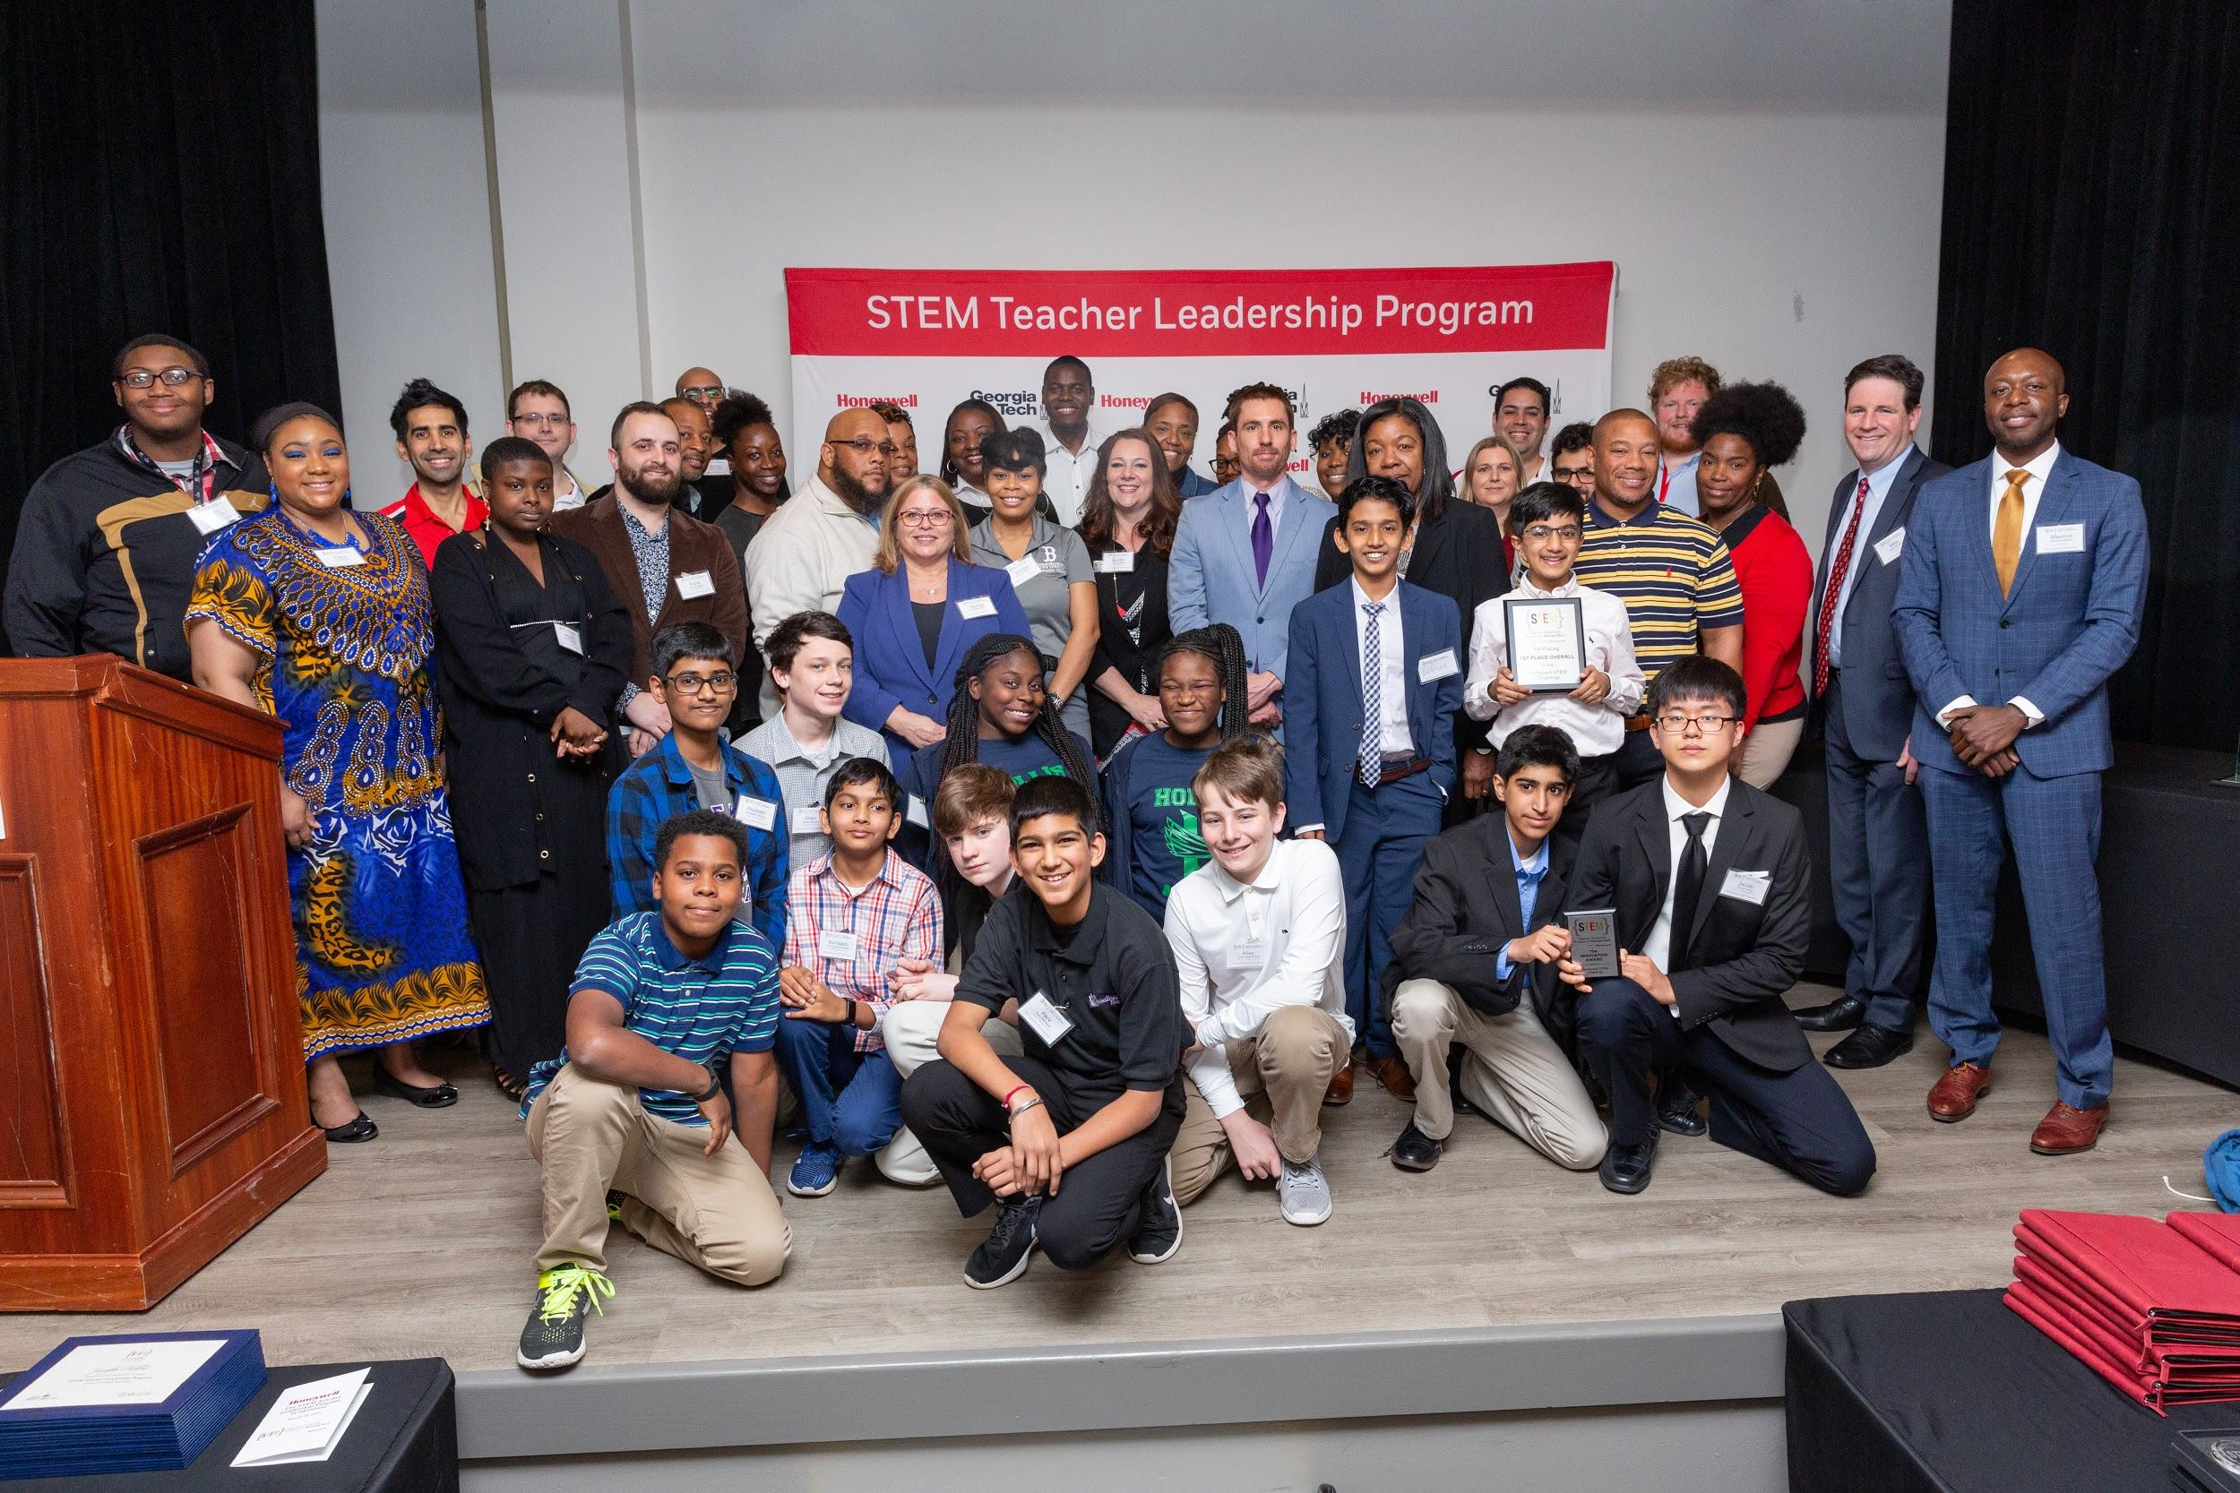

Slide 3
The Challenge
Task: Design a technology-based solution to a problem in your home, school or community. The solution you design should be a driver of social good.
Theme: Disaster preparedness and response -- How can your project help avert, prepare for, or respond to natural or manmade disasters and crisis?

Slide 4
Examples
Home Solutions: Child safety from accidental injuries; safe homes (burglary, fire, floods, gas leaks, intrusion); assistance for people with physical disabilities; assistance for the elderly; “smart” homes.
School Solutions: Interactive education related to the theme; controlling/monitoring resources (such as water, food or energy); school safety/crisis situations (weather events, situations involving hazardous materials, armed intruder, bomb threat); “smart” schools.
Community Solutions: Access to clean water; environmental monitoring; wearable technology; decreasing hunger; safe cities; using data to target community problems;“smart” cities.

Slide 5
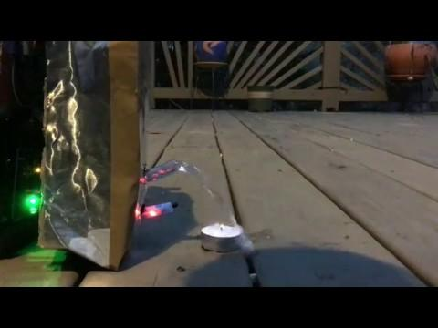
Past Projects - Firebot
Aryan Thakkar, Jacob Sung, Kavin Kumaresan, and Maxwell Wang
Autrey Mill Middle School
Fulton County
Teacher: Sharon McGee
Winner of the Innovation Award

Slide 6
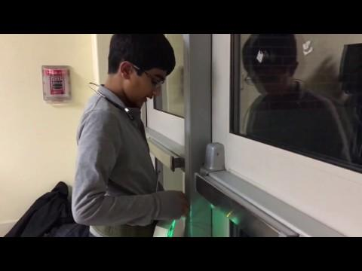
Past Projects - Blindsight
Divij Motwani & Pettrus Konnoth
Autrey Mill Middle School
Fulton County
Teacher: Sharon McGee
Winner of 1st Place Overall

Slide 7
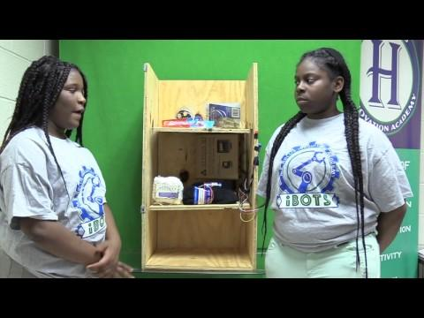
Past Projects - Blindsight
Iyahna Wright, Sa'Niya Fallin, Takeria Evans, and Nyla Smith
Hollis Innovation Academy
Atlanta Public Schools
Teacher: Nichole Jones
Winner of the Impact Award

Slide 8
The Basics
Platform: Students may use any or all supplies found in one micro:bit tinker kit. Any additional supplies count towards the project’s spending limit. Projects may also be stand-alone scripts or programs that do not require the use of a micro:bit.
Coding language: Any
Spending limit: $30 per project (excludes micro:bit tinker kit and basic arts/craft supplies provided by the teacher).
Team projects: Projects of 2 - 4 students, limit of 15 projects per teacher.

Slide 9
The Dates
August 19, 2019 -- STEM Challenge Announcement
  (The previous cohort of STLP teachers also is invited)
September 20, 2019 -- Schools submit max project count estimates
November 20, 2019 -- Final submission of STEM Challenge projects
December 18, 2019 -- STEM Challenge finalists announced
January 30, 2020 -- STEM Challenge showcase at GT. Overall winners determined

Slide 10
The Submission
Expected outcome: A prototype that demonstrates the concept of the solution, crafted using the engineering design process.
Challenge Log: Students must document their design process through a “challenge log.” See the Challenge Framework for more details.
Video Presentation: A proof-of-concept and project overview video, uploaded to Youtube, no longer than 10 minutes. See Challenge Framework for more details.

Slide 11
The Winners
Initial Finalists Pool (25 Finalists, Before Showcase):
  20 Top Projects from the districts by proportion of STLP participation
  5 overall top projects (regardless of district and not from within the 20)
Final Overall Winners (10 winners, Determined at Showcase):
  Top 3 Overall by Division
    Top 3 Middle School Projects (Junior Division)
    Top 3 High School Projects (Senior Division)
  Two Special Awards
    Innovation Award -- For the project demonstrating a novel or exceptionally creative solution within the Honeywell STEM Challenge.
    Impact Award -- For the project demonstrating an exceptional and realistic impact for social good in one’s home, school, or community.

Slide 12
The Nitty Gritty
See the STEM Challenge Framework for more details like:
Project examples
Challenge Log criteria
The initial rubric
How to register
...and more! Be sure to read it!

Slide 13


